Slide 1
Chapter 8: Relational Database Design

Slide 2
Chapter 8: Relational Database Design
Features of Good Relational Design
Atomic Domains and First Normal Form
Decomposition Using Functional Dependencies
Second Normal Form
Boyce-Codd Normal Form
Third Normal Form

Slide 3
Normalization
We use E-R diagrams to generate a set of relation schemas.
Obviously, the goodness (or badness) of the resulting set of schemas depends on how good the E-R design was in the first place.
There is a good chance that imperfections exist in your ER design which can propagate to the resulting schema diagrams.
But how do we formally assess whether the relation schemas that we obtain is good or bad?

Slide 4
Normalization
The normalization process, as first proposed by Codd (1972), takes a relation schema through a series of tests to certify whether it satisfies a certain normal form.
Initially, Codd proposed three normal forms, which he called first, second, and third normal form.
A stronger definition of 3NF—called Boyce-Codd normal form (BCNF)—was proposed later by Boyce and Codd.
All these normal forms are based on the functional dependencies among the attributes of a relation.
Later, a fourth normal form (4NF) and a fifth normal form (5NF) were proposed, based on the concepts of multivalued dependencies and join dependencies, respectively.

Slide 5
Normalization
The normal form of a relation refers to the highest normal form condition that it meets, and hence indicates the degree to which it has been normalized.
Normal forms, when considered in isolation from other factors, do not guarantee a good database design.
Rather, the process of normalization through decomposition must also confirm the existence of additional properties that the relational schemas, taken together, should possess. These would include two properties:
The lossless join property, which guarantees that spurious tuples are not generated by the relation schemas created after decomposition.
The dependency preservation property, which ensures that each functional dependency is represented in some individual relation resulting after decomposition.
The lossless join property is extremely critical and must be achieved at any cost, whereas the dependency preservation property, although desirable, is sometimes sacrificed.

Slide 6
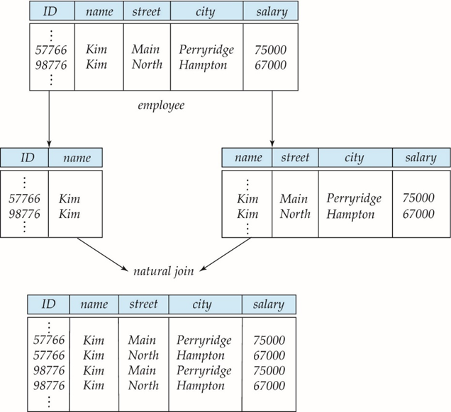
Lossy/ Loseless Decomposition
Suppose we decompose the schema employee(ID, name, street, city, salary)
into the following two schemas
employee1 (ID, name)
employee2 (name, street, city, salary)
As can be seen in the figure, this is a lossy decomposition as we cannot reconstruct the original employee relation.
On the other hand, decompositions that do not lose the original information are known as lossless decomposition.
We should be aiming for a lossless decomposition.

Slide 7
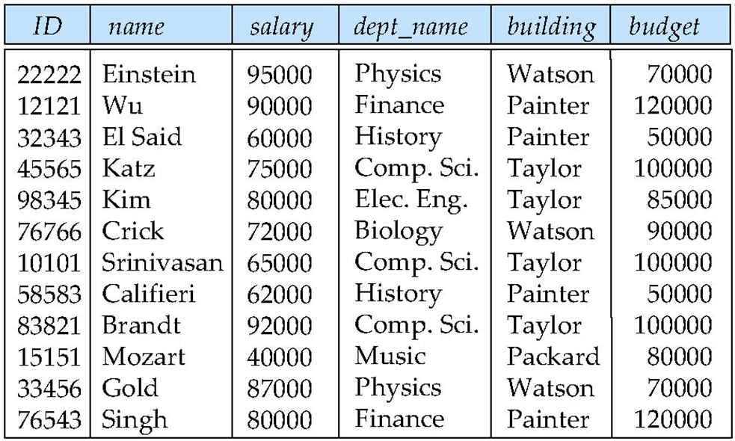
Case Study - Design Alternative
Previously, we had the schemas instructor and department:
instructor(ID, name, dept_name, salary)
department(dept_name, building, budget)
Suppose that instead of instructor and department schemas, we have the following combined schema
inst_dept (ID, name, salary, dept_name, building, budget)
What could be the possible problems with this design?

Slide 8

Case Study - Design Alternative
What could be the possible problems with this design?
department information (“building” and “budget”) repeats once for each instructor in the department
runs the risk that some user might update the budget amount in one tuple but not all, and thus create inconsistency
we cannot represent directly the information concerning a department (dept name, building, budget) unless that department has at least one instructor at the university.

Slide 9
Case Study - Design Alternative
Suppose we had started out with the schema inst_dept. How would we recognize that it results in redundancy and should be split up (decompose) into two schemas instructor and department?
By observing the contents of actual relations on schema inst_dept, we could note the repetition of information resulting from having to list the building and budget once for each instructor associated with a department.
However, this is an unreliable process.
A real-world database has a large number of schemas and an even larger number of attributes. The number of tuples can be in the millions or higher.
Discovering repetition would be costly.
There is an even more fundamental problem with this approach.
It does not allow us to determine whether the lack of repetition is just a “lucky” special case or whether it is a manifestation of a general rule.
In our example, how would we know that in our university organization, each department must reside in a single building and must have a single budget amount?

Slide 10
Case Study - Design Alternative
We need to allow the database designer to specify rules such as
“Each specific value for dept_name corresponds to atmost one budget”
“Each specific value for dept_name corresponds to atmost one building”
Rules such as these are specified as what we call a functional dependency denoted as:
dept_name → building, budget
Given such a rule, we now have sufficient information to recognize the problem of the inst_dept schema.
In inst_dept, because dept_name is not a primary key, the building and budget of a department may have to be repeated.
Observations such as these and the rules (functional dependencies in particular) that result from them allow the database designer to recognize situations where a schema ought to be decomposed into two or more schemas.
But how do we find the right decomposition?
Through normalization

Slide 11
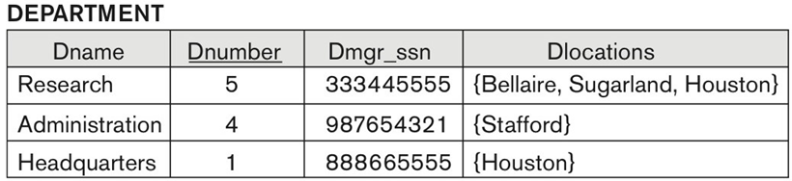
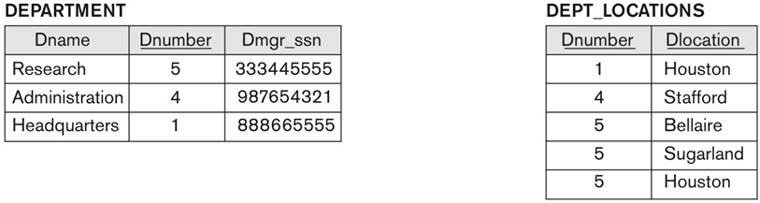
First Normal Form
A domain is atomic if elements of the domain are considered to be indivisible units.
In the department schema below, Dlocations is not atomic.
We say that a relation schema R is in first normal form (1NF) if the domains of all attributes of R are atomic.
Hence, the above relation is not in first normal form.
To achieve 1NF, remove the attribute Dlocations that violates 1NF and place it in a separate relation DEPT_LOCATIONS along with the primary key Dnumber of DEPARTMENT.
The primary key of this newly formed relation is the combination {Dnumber, Dlocation}, as shown in the figure

Slide 12
Functional Dependencies
A functional dependency allows us to express constraints that uniquely identify the values of certain attributes.
Let r(R) be a relation schema
α ⊆ R and β ⊆ R
The functional dependency α → β holds on an instance of r(R), if and only if, whenever any two tuples t₁ and t₂ of r agree on the attributes α, they also agree on the attributes β. That is,
t₁[α] = t₂ [α] ⇒ t₁[β ] = t₂ [β ]
Example: Consider the following instance of department(dept_name, budget).
On this instance, the functional dependency dept_name → budget holds but budget → dept_name does not hold.
dept_name | budget
CS | 100000
Math | 75000
Biology | 75000

Slide 13
Functional Dependencies (Cont.)
K is a superkey for relation schema r(R) if and only if K → R
K is a candidate key for R if and only if
K → R, and
for no α ⊂ K, α → R
Functional dependencies allow us to express constraints that cannot be expressed using superkeys. Consider the schema:
inst_dept (ID, name, salary, dept_name, building, budget )
We expect these functional dependencies to hold:
dept_name→ building
and ID → building
but would not expect the following to hold:
dept_name → salary

Slide 14
Functional Dependencies (Cont.)
If a relation r satisfies a set F of functional dependencies, we say that r satisfies F or F holds on r.
Note: A specific instance of a relation schema may satisfy a functional dependency even if the functional dependency does not hold on all legal instances.
For example, a specific instance of department may, by chance, satisfy budget → dept_name.
But this does not mean that this functional dependency holds on the relation department
dept_name | budget
CS | 100000
Math | 75000
Biology | 50000

Slide 15
Functional Dependencies (Cont.)
A functional dependency is trivial if it is satisfied by all instances of a relation
Example:
ID, name → ID
name → name
In general, α → β is trivial if β ⊆ α

Slide 16
Closure of a Set of Functional Dependencies
Given a set F of functional dependencies, there are certain other functional dependencies that are logically implied by F.
For example, let’s say that F consists of two functional dependencies: A → B and B → C
Then we can infer from the above two dependencies that A → C
The set of all functional dependencies logically implied by F is the closure of F.
We denote the closure of F by F⁺.
F⁺ is a superset of F.

Slide 17
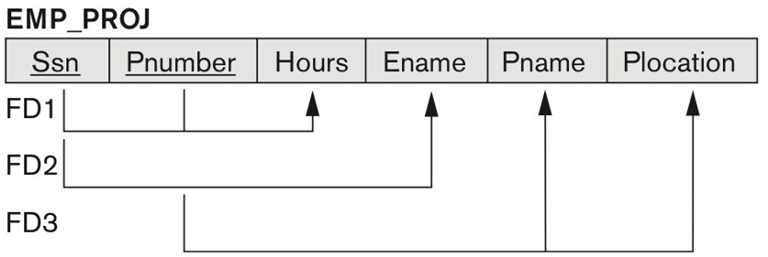
Partial Dependency
A functional dependency α → β is called a partial dependency if there is a proper subset γ of α such that γ → β. We say that β is partially dependent on α .
Consider the following EMP_PROJ schema with three functional dependencies:
{Ssn, Pnumber} form the primary key and hence can uniquely identify every other attribute in the schema, i.e., there is an implicit functional dependency from {Ssn, Pnumber} to every other attribute.
For instance, {Ssn, Pnumber} → Ename
However, Ssn → Ename also holds true. And since Ssn is a proper subset of {Ssn, Pnumber}, the dependency {Ssn, Pnumber} → Ename is partial.

Slide 18
Second Normal Form
A relation schema R is in second normal form (2NF) if each attribute A in R meets one of the following criteria:
It appears in a candidate key.
It is not partially dependent on a candidate key.
{Pname, Plocation} can be determined by Pnumber alone and {Pname, Plocation} are not part of any candidate key.
So, the above schema is not in 2NF.

Slide 19
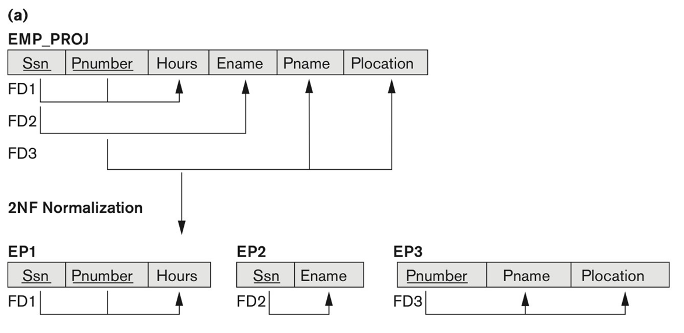
Second Normal Form
If a relation schema is not in 2NF, it can be second normalized into a number of 2NF relations in which nonprime attributes are associated only with the part of the primary key on which they are fully functionally dependent.

Slide 20
Boyce-Codd Normal Form
A relation schema R is in BCNF with respect to a set F of functional dependencies if for all functional dependencies in F⁺ of the form
α → β
where α ⊆ R and β ⊆ R, at least one of the following holds:
α → β is trivial (i.e., β ⊆ α)
α is a superkey for R
Example schema not in BCNF:
instr_dept (ID, name, salary, dept_name, building, budget )
because dept_name → building, budget holds on instr_dept
But dept_name is not a superkey and the functional dependency is not trivial.

Slide 21
Decomposing a Schema into BCNF
Suppose we have a schema R and a non-trivial dependency α →β causes a violation of BCNF.
We decompose the schema R into two schemas:
(α U β )
( R - ( β - α ) )
In our example,
The schema is
instr_dept (ID, name, salary, dept_name, building, budget )
The non-trivial dependency is
dept_name → building, budget
So, α = dept_name and β = building, budget
inst_dept is, thus, replaced by
(α U β ) = ( dept_name, building, budget )
( R - ( β - α ) ) = ( ID, name, salary, dept_name )

Slide 22
BCNF and Dependency Preservation
Functional dependencies should exist within a single relation
Computationally costly to check functional dependencies that exist between multiple relationships
However, in some cases, decomposition into BCNF can result in the loss of a functional dependency within a single relation.
Consider the following schema:
dept_advisor (s_ID, i_ID, dept_name)
The following constraints hold on this schema:
An instructor can act as an advisor for only one department.
A student may have more than one advisor but at most one advisor for a given department.
Based on the above, the following functional dependencies hold on dept_advisor:
i_ID→dept_name
s_ID, dept_name→i_ID

Slide 23
BCNF and Dependency Preservation
dept_advisor (s_ID, i_ID, dept_name) is, however, not in BCNF.
For the functional dependency,
i_ID→dept_name,
the dependency is not trivial and i_id is not a superkey.
Following our rule for BCNF decomposition, we get the following two schemas:
(i_ID, dept_name)
(s_ID, i_ID)
Both the above schemas are BCNF.
Note however, that in our BCNF design, there is no schema that includes all the attributes appearing in the functional dependency
s_ID, dept_name→i_ID.
Because our design makes it computationally hard to enforce this functional dependency, we say our design is not dependency preserving.
Because dependency preservation is usually considered desirable, we consider another normal form, weaker than BCNF, that will allow us to preserve dependencies. That normal form is called third normal form.

Slide 24
Third Normal Form
A relation schema R is in third normal form (3NF) if for all functional dependencies in F⁺ of the form α → β , where α ⊆ R and β ⊆ R, at least one of the following holds:
α → β is trivial (i.e., β ∈ α)
α is a superkey for R
Each attribute A in β – α is contained in a candidate key for R.
Note that the third condition above does not say that a single candidate key must contain all the attributes in β – α; each attribute A in β – α may be contained in a different candidate key.
Also note that a candidate key is a minimal superkey - that is, a superkey no proper subset of which is also a superkey.
If a relation is in BCNF it is in 3NF.
Third condition is a minimal relaxation of BCNF to ensure dependency preservation.

Slide 25
Third Normal Form
Now let’s again consider the schema
dept_advisor (s_ID, i_ID, dept_name)
For the functional dependency,
s_ID, dept_name→i_ID
{s_ID, dept_name} is a superkey (and also a candidate key)
For the functional dependency,
i_ID→dept_name,
α = i_ID, β = dept_name and β – α = dept_name
β – α = dept_name is contained in the candidate key {s_ID, dept_name}
Since both the functional dependencies hold on dept_advisor, it is in third normal form.

Slide 26
Comparison of BCNF and 3NF
The goals of a relational database design with functional dependencies are:
BCNF
Lossless join
Dependency preservation
Since it is not always possible to preserve dependency with BCNF, we may be forced to choose between BCNF and dependency preservation with 3NF.

Slide 27
End of Chapter

